Slide 1
In Search of Leveraged Returns for Long-term Investment
Jeff Stollman
Rocky Mountain Technical Marketing, Inc.

Slide 2
Assumptions
It is hard to outperform the market on a sustained, long-term basis.
Certain broad indices (e.g., S&P 500) provide diversity and have shown the ability to increase in value over long periods of time
Obtaining leveraged returns on such indices is desirable to long-term investors seeking returns in excess of the long-term gains of these broad indices.

Slide 3
Desirable Characteristics of Leveraged Long-term Investment Vehicle
Broad coverage
Portfolio Visibility
Valuation transparency
Suitability for retirement accounts
  No margin calls
US tax advantaged

Slide 4
Investment Candidates
Purchase of non-leveraged index funds on margin (State Street SPDR® S&P 500® ETF)
Leveraged Index Products (LIPs) that re-index based on time (ProShares 2X S&P500 ETF)
LIPs based on nominal change that don’t reindex
LIPs based on nominal change that don’t reindex w/kill switch (Barclays iPath® extended ETN)
LIPs based on nominal change that reindex based on value (UBS FI Enhanced Big Cap Growth ETN)
LIPs based on nominal change that don’t reindex using Φ-FundTM technology (Φ-Fund™ C)

Slide 5
Broad coverage

Slide 6
Linking Funds to Indices
Provides Broad Coverage
Many indices specific target providing broad coverage
Selection of appropriate indices as the underlying basis of a fund provides the identical breadth afforded by the index, itself

Slide 7
Portfolio Visibility

Slide 8
Linking Funds to Indices
Also Provides Portfolio Visibility
Most indices identify their components
Most Indices change components infrequently
Announcements of changes are generally advertised in advance and widely desiminated
Selection of appropriate indexes as the underlying basis of a fund provides the identical visibility afforded by the index, itself

Slide 9
Valuation Transparency
Notes:
Valuation transparency refers to the ability to know the value of the investment, given the value of the underlying index. Many current leveraged index products rely on reindexing in order to maintain their valuation targets. This reindexing introduces path dependency, so that knowing the value of the underlying index is no longer sufficient to know the value of the fund.

Slide 10
The Reindexing Problem
TRADING DAY | INDEX | DAILY % CHANGE in INDEX | OVERALL % CHANGE in INDEX | 2X FUND SHARE PRICE | DAILY % CHANGE in FUND | OVERALL % CHANGE in FUND
0 | 100.00 |  |  | 100.00
1 | 102.00 | 2.00% | 2.00% | 104.00 | 4.00% | 4.00%
2 | 108.00 | 5.88% | 8.00% | 116.24 | 11.76% | 16.24%
3 | 110.00 | 1.85% | 10.00% | 120.54 | 3.70% | 20.54%
4 | 105.00 | -4.55% | 5.00% | 109.58 | -9.09% | 9.58%
5 | 100.00 | -4.76% | 0.00% | 99.15 | -9.52% | -0.85%
Notes:
We illustrate Re-indexing using a standard 2X leveraged ETF.
Assume that the imaginary index opens for trading with a value of 100 and an investor purchases a share of the 2X fund at the opening which also has an initial value of 100.
After the first day of trading, the Index rises 2% and the 2X fund rises double that or 4%.
Even though the investor’s basis is 100, the fund now reindexes, changing its basis to 104. This is done to accurately reflect the percentage change in the fund over the next trading day.

Slide 11
Defining the Re-indexing Problem
TRADING DAY | INDEX | DAILY % CHANGE in INDEX | OVERALL % CHANGE in INDEX | 2X FUND SHARE PRICE | DAILY % CHANGE in FUND | OVERALL % CHANGE in FUND
0 | 100.00 |  |  | 100.00
1 | 102.00 | 2.00% | 2.00% | 104.00 | 4.00% | 4.00%
2 | 108.00 | 5.88% | 8.00% | 116.24 | 11.76% | 16.24%
3 | 110.00 | 1.85% | 10.00% | 120.54 | 3.70% | 20.54%
4 | 105.00 | -4.55% | 5.00% | 109.58 | -9.09% | 9.58%
5 | 100.00 | -4.76% | 0.00% | 99.15 | -9.52% | -0.85%
Notes:
On the second trading day, the market continues to move in the same upward direction. The Index rises and additional 5.88%, causing the Fund to rise 11.76%. For the Day 0 investor, the Fund has begun to lose fidelity with the underlying index, having risen slightly more than double the Overall percentage change in the index (16.24% vs. 16% (2 * 8%). But since it is in the investor’s favor, no investor is concerned.

Slide 12
Defining the Re-indexing Problem
TRADING DAY | INDEX | DAILY % CHANGE in INDEX | OVERALL % CHANGE in INDEX | 2X FUND SHARE PRICE | DAILY % CHANGE in FUND | OVERALL % CHANGE in FUND
0 | 100.00 |  |  | 100.00
1 | 102.00 | 2.00% | 2.00% | 104.00 | 4.00% | 4.00%
2 | 108.00 | 5.88% | 8.00% | 116.24 | 11.76% | 16.24%
3 | 110.00 | 1.85% | 10.00% | 120.54 | 3.70% | 20.54%
4 | 105.00 | -4.55% | 5.00% | 109.58 | -9.09% | 9.58%
5 | 100.00 | -4.76% | 0.00% | 99.15 | -9.52% | -0.85%
Notes:
On the third trading day, the trend continues upward. The index has now risen 10% The Fund has risen more than double: up 20.54% Again, no investor is complaining about increased returns.

Slide 13
Defining the Re-indexing Problem
TRADING DAY | INDEX | DAILY % CHANGE in INDEX | OVERALL % CHANGE in INDEX | 2X FUND SHARE PRICE | DAILY % CHANGE in FUND | OVERALL % CHANGE in FUND
0 | 100.00 |  |  | 100.00
1 | 102.00 | 2.00% | 2.00% | 104.00 | 4.00% | 4.00%
2 | 108.00 | 5.88% | 8.00% | 116.24 | 11.76% | 16.24%
3 | 110.00 | 1.85% | 10.00% | 120.54 | 3.70% | 20.54%
4 | 105.00 | -4.55% | 5.00% | 109.58 | -9.09% | 9.58%
5 | 100.00 | -4.76% | 0.00% | 99.15 | -9.52% | -0.85%
Notes:
On Day 4, the market changes direction. The Index remains up 5% Overall. But notice that the Fund has gone from outperforming (20.54% vs. predicted 20%) to underperforming the index (+9.58% vs. predicted +10%).

Slide 14
Defining the Re-indexing Problem
TRADING DAY | INDEX | DAILY % CHANGE in INDEX | OVERALL % CHANGE in INDEX | 2X FUND SHARE PRICE | DAILY % CHANGE in FUND | OVERALL % CHANGE in FUND
0 | 100.00 |  |  | 100.00
1 | 102.00 | 2.00% | 2.00% | 104.00 | 4.00% | 4.00%
2 | 108.00 | 5.88% | 8.00% | 116.24 | 11.76% | 16.24%
3 | 110.00 | 1.85% | 10.00% | 120.54 | 3.70% | 20.54%
4 | 105.00 | -4.55% | 5.00% | 109.58 | -9.09% | 9.58%
5 | 100.00 | -4.76% | 0.00% | 99.15 | -9.52% | -0.85%
Notes:
After another day of declines, the Index is back to a neutral position – unchanged from its starting point. But the investor is now underwater – having lost almost 1%!

Slide 15
Inverse Funds
TRADING DAY | INDEX | DAILY % CHANGE in INDEX | OVERALL % CHANGE in INDEX | -2X FUND SHARE PRICE | DAILY % CHANGE in FUND | OVERALL % CHANGE in FUND
0 | 100.00 |  |  | 100.00
1 | 102.00 | 2.00% | 2.00% | 96.00 | -4.00% | -4.00%
2 | 108.00 | 5.88% | 8.00% | 84.71 | -11.76% | -15.29%
3 | 110.00 | 1.85% | 10.00% | 81.57 | -3.70% | -18.43%
4 | 105.00 | -4.55% | 5.00% | 88.98 | 9.09% | -11.02%
5 | 100.00 | -4.76% | 0.00% | 97.46 | 9.52% | -2.54%
Notes:
The problem is exacerbated with inverse funds. Using the same changes in our imaginary Index, a -2X leveraged fund has lost 2.5% of its value – even though the underlying Index is unchanged.
It turns out that the real return of today’s leveraged index funds is “path dependent.” In the above example, if the index had gone up 10% on Day 1 and returned to 100 on Day 2, the -2X fund share would decline to 98.2, a decline of only 1.8%. Because of this path dependence, the value of the fund at any future point – even if the value of the underlying index can be estimated with accuracy – is not predictable. It will vary depending on the path of daily changes the index takes to get to the new value.

Slide 16
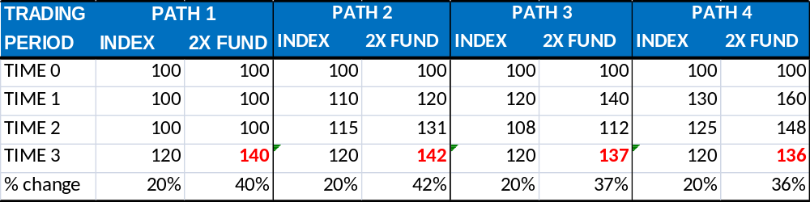
What’s the Value?
Notes:
Four paths; four different values.

Slide 17
Suitability for retirement accounts
Notes:
Suitability for retirement accounts in the US generally includes the following characteristics:
The investment cannot lose more than its initial value
The investment does not incur margin calls

Slide 18
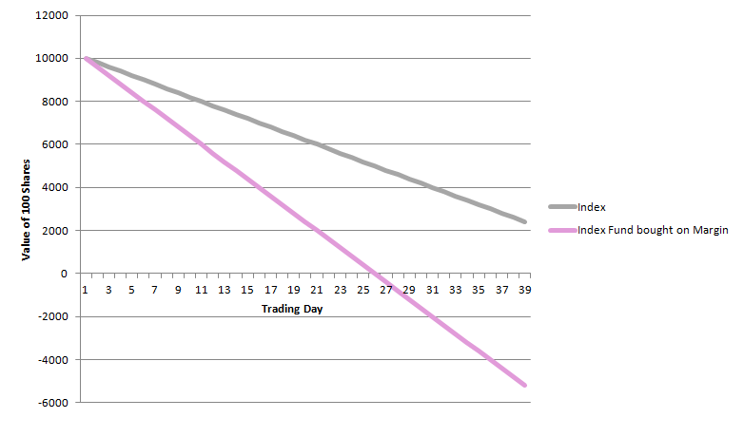
Margin Calls: Keeping Away from Zero
Notes:
One of the critical downsides of buying anything on margin is the risk of a margin call. Not only does this require the investor to add capital to his account to cover the margin call, it has the result of reducing the leverage for the investment. Because buying on margin can cause an investor to lose more than his initial investment, such investments are also precluded from being made in retirement accounts.
Buying on margin is not the only circumstance that could create a margin call. The same curve would apply to any LIP that tracks the daily nominal change in the underlying index.
The problem with tracking the daily nominal change is that an overall decline of 50% in the index of a 2X fund would bring the LIP to zero. For a 3X fund, the change would need to be only 33%. While most broad indices don’t commonly lose such large chunks of their value, consider an inverse fund whose value declines as the index rises. An appreciation of 50% for a 2X fund or 33% for a 3X fund would have the same impact, prompting a margin call.

Slide 19
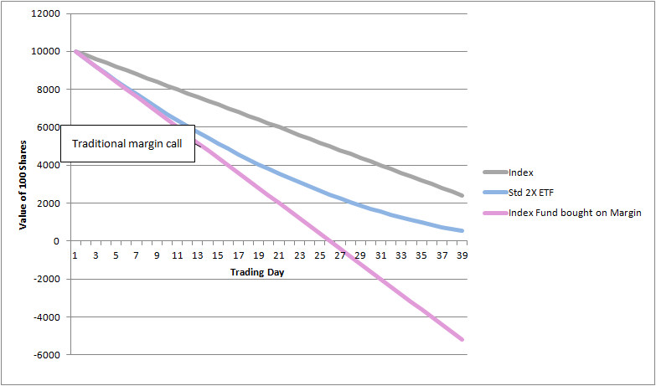
No Margin Calls
Notes:
Reindexing based on time has the benefit of avoiding margin calls. In order for a margin call to occur, the index of a 2X fund would have to decline 50% intraday (33% for a 3X fund). For most indices, this is a highly unlikely occurrence.

Slide 20
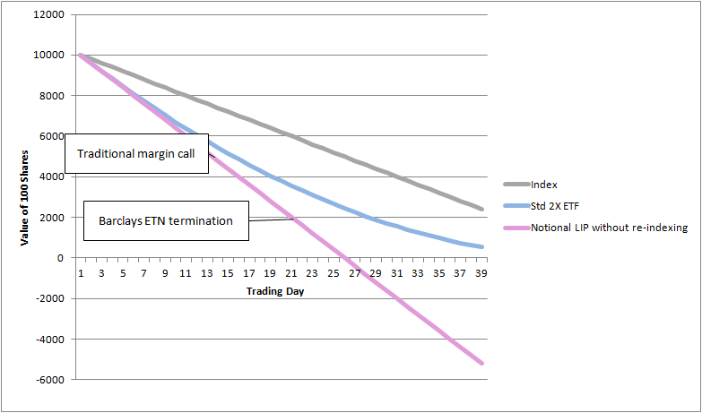
No Margin Calls: Kill Switch
Notes:
Another problem with this approach is that it is subject to margin calls. Barclays addressed this problem with their Barclays iPath® extended ETNs, by implementing a kill switch. When an iPath® extended ETN declines to 80% of its initial value, Barclays terminates the ETN. This avoids margin calls, but may not be a desirable result to investors who are interested in the fund and the substantial leverage that can be attained by purchasing near the terminal price. Another consequence of this approach is that if the value does approach the terminal price, liquidity may dry up because investors won’t want to purchase an asset that could be terminated if it declines a bit further – even if the investor is certain that it is due to rise significantly.
Because of the margin-call issue, funds without kill switches are not suitable for long-term investment.

Slide 21
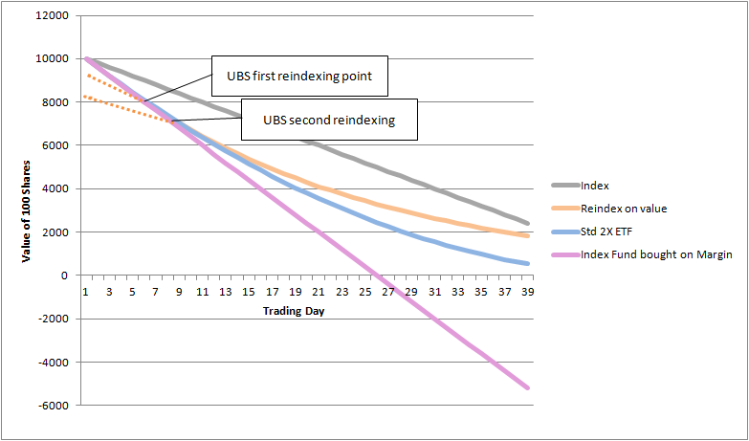
No Margin Calls: Path Dependence
Notes:
But, should the value decline enough to trigger the re-indexing, it suffers from path dependence.
While the UBS ETN goes down smoothly and never hits zero, because it reindexes, it has difficulty attaining its original values when the market goes back up.
The dotted lines show that the ETN will not rise as fast as it declined because of the re-indexing that takes place. And the ability to retrace becomes increasingly difficult each time the ETN incurs subsequent re-indexing events.
This risk makes such an asset inappropriate for long-term investment unless a stop-loss is implemented to avoid reindexing. Assuming that other investors may implement similar stop-loss orders, the ETN may experience a slippery slope if its value approaches a reindexing trigger value.
UBS does offer non-exchange–traded notes that reindex in both directions. This removes path dependence and preserves valuation transparency. But these products are not exchange traded presumably to avoid having arbitragers gaming them when the values approach a reindexing point.

Slide 22
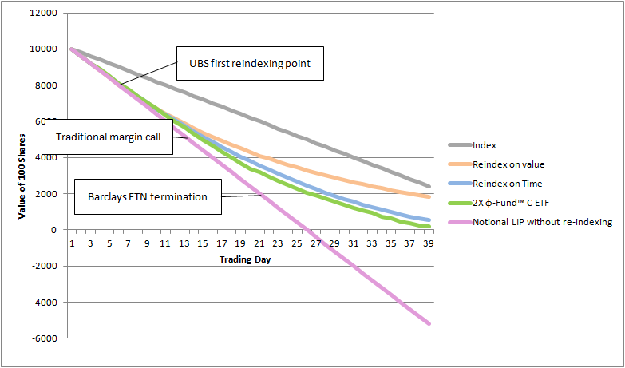
No Margin Calls, No Path Dependence
Notes:
The φ-Fund™ C 2X ETF has been conceived explicitly to avoid going to zero and to closely approximate a steady decline in the standard 2X ETF.
But, as long as the valuation curve is a function, it can be given any shape and avoid path dependence. And because it has no reindexing trigger points, it offers no trigger points for arbitragers to game.

Slide 23
US Tax Advantaged

Slide 24
The Structure of a Fund Can Provide Tax Advantages
If swap-based hedges are not directly tied to the underlying collateral of the counter-party, the fund may be free from taxable distributions
Using a holding period of longer than 1 year makes the investment eligible to be task as a long-term capital gain

Slide 25
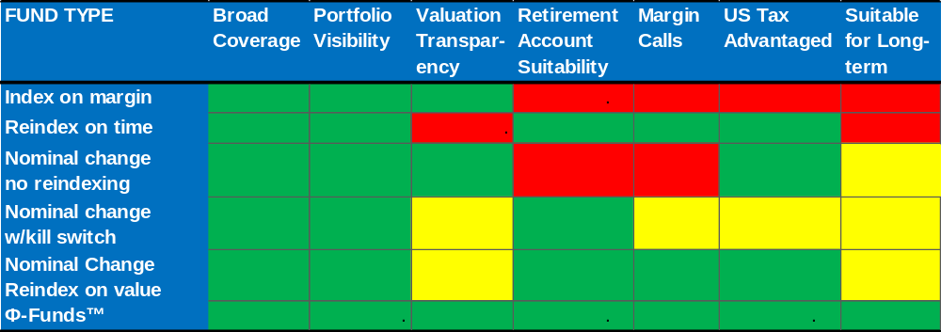
Broad Coverage
Notes:
Because of being index based, all of the alternatives can provide broad coverage – subject to the selection of an index offering broad coverage.

Slide 26
Portfolio Visibility
Notes:
Because of being index based, all of the alternatives can provide portfolio visibility – equal to that of their underlying index.

Slide 27
Valuation Transparency
Notes:
The daily/monthly reindexing of funds that reindex based on time makes their valuation difficult to ascertain in terms of their underlying index. As we saw in the example, investors can even lose money when they correctly forecast the direction of the index.
Similarly, nominal-change funds that reindex based on value may suffer from this same fault, IF their value decreases sufficiently to trigger reindexing.
I have also put a caution warning on nominal change funds that include a kill switch. While their value is ascertainable throughout their range, the limitations of their range can trigger the equivalent of a forced stop-loss that is undesirable. As prices approach the kill switch level, market liquidity may dry up, causing the fund to lose value ahead of the underlying index.

Slide 28
Retirement Account Suitability
Notes:
Purchasing an index on margin is no suitable for a retirement account because the investor can lose more than his initial investment.
Nominal change funds without reindexing can go negative prompting either a margin call or losses beyond the initial investment.

Slide 29
Margin Calls
Notes:
Both of the investments that are unsuitable for retirement accounts suffer from margin calls – an unwelcome problem even if they are held outside of a retirement account.
In addition, however, nominal change funds that employ a kill switch act somewhat like a margin call. They force liquidation, rather than demanding additional margin.

Slide 30
US Tax Advantaged
Notes:
With the exception of buying a non-leveraged index on margin, all of the other LIPs can be structured with a swap basis to avoid taxable distributions during their holding periods.
I assigned a yellow box to Nominal change LIPs that employ a kill switch, because the investment may find his position closed out before he can even attain a capital gain – whether it be short-term or long-term.

Slide 31
Summary:
Suitable for Long-term Investment

Slide 32
What is a φ-fund™?

Slide 33
φ-Fund™ Characteristics
Requires an underlying index
Links fund value to the index via a third variable: φ
  May use a nominal change basis for leverage
  Cannot use a percentage change basis for leverage
  Can approximate a percentage change basis
Φ must have a functional relationship to the underlying index
Notes:
Creating a φ-Fund™ that is based on a nominal change is only one construction. A φ-Fund™ can be constructed to follow any valuation curve – including arbitrary ones.
But significant benefits can accrue to φ-Funds™ that use simple constructs. Examples include the following:
A fund that closely approximates current leveraged index fund returns if they were to consistently move up or down without volatility
A nominal-change based fund that uses zero (or some other value) as an asymptote to prevent the fund from ever losing all its value or turning negative
A fund similar to the nominal change fund above whose leverage declines more slowly as the fund increases in value.

Slide 34
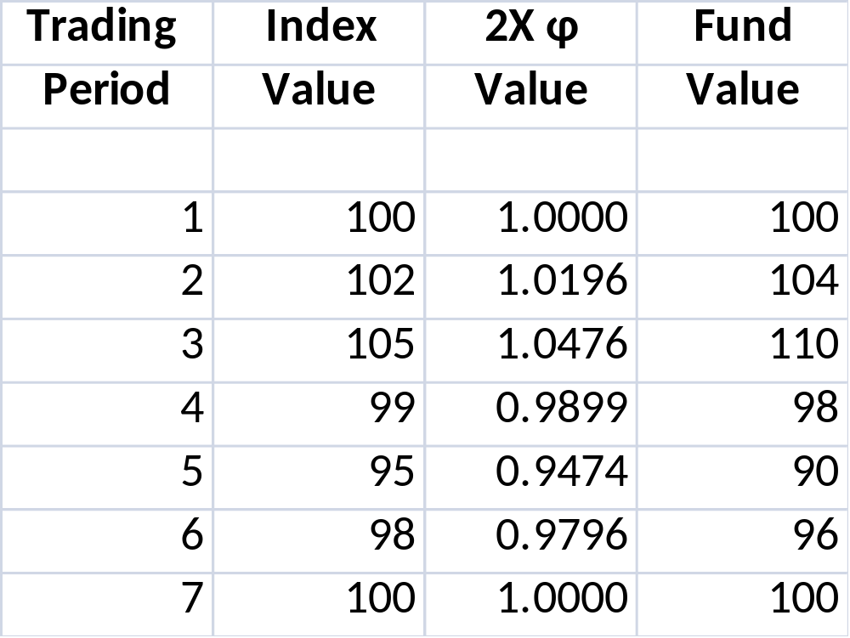
φ-Fund™ Path Illustration
Notes:
This illustration shows a simple 2X nominal change illustration of φ-Fund™ technology. The value of the fund is calculated by multiplying the Index Value by φ.
Since this particular illustration could also be accomplished using a simple nominal change calculation, the φ-Fund™ approach offers little value add.
The power of φ-Fund™ technology comes from its ability to generate a wide-variety of valuation curves, such as the one previously illustrated that mirrors the pattern of a steadily declining tradition 2X reindexing fund without incurring path dependence.

Slide 35
No Margin Calls, No Path Dependence
Notes:
But this is only one possibility. φ-Fund™ technology can take on a wide variety of curves. But regardless of shape, they maintain valuation transparency and path independence.

Slide 36
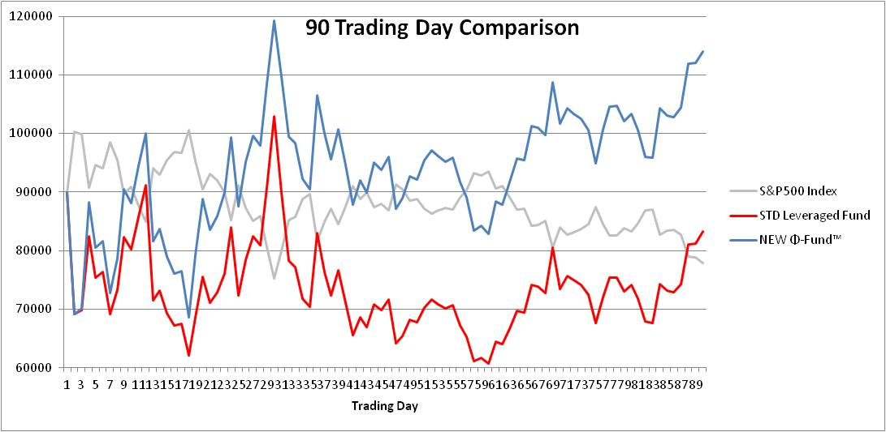
Performance Comparison
Notes:
The above illustration compares the value of 100 shares of a traditional inverse 2X LIP vs. a φ-Fund™.
The underlying index is the S&P 500 beginning on 10 Oct 2008.
Even though the S&P declined nearly 13.5% over this period (899 to 779), the standard -2X Leveraged Index Fund, rather than increasing in value by 27%, actually lost 7.5%.
The -2X φ-Fund™ returned the full 27%.
Admittedly this period was a very volatile time for the market which shows a particularly strong bias against standard Leveraged Index ETFs. But, unless the market endures a prolonged trend in the same direction, it illustrates the comparative risk of the two approaches.

Slide 37
For more information
Jeff Stollman
stollman.j@gmail.com
+1 202.683.8699

